Slide 1








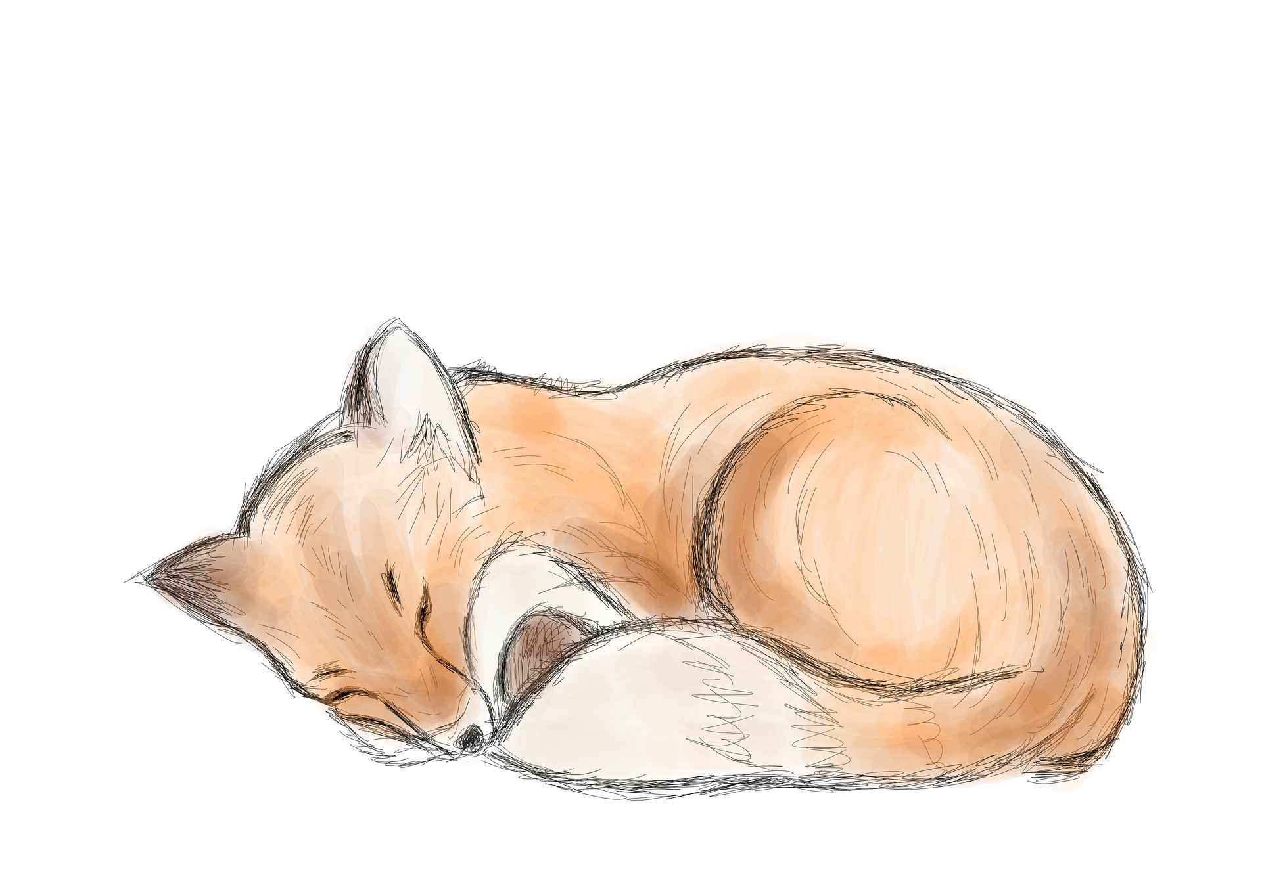





Quick Tweet
CSCI 3130 - Group01

Slide 2

Overview
QuickTweet is a text post-based app modelled after Twitter
Users are able to
Join different groups based on their interests
Write text posts on any topics they desire
Meet new people and add them as friends
QuickTweet’s simple design is meant to give users a break from the often exhausting nature of browsing a social media app
Notes:
Make sure to mention that we didn’t implement endless scrolling for the sake of users’ “mental health”, and that QuickTweet i

Slide 3
Daily SCRUM meetings, 5-10 minutes
Teamwork
Weekly Sprint Planning and Retrospective
To stay organized, keep things fair, and deliver work on time, our team implemented a few main principles.
Weighted tasks, team members take-on tasks appropriate for their skill level
Accommodations for personal schedules

Slide 4
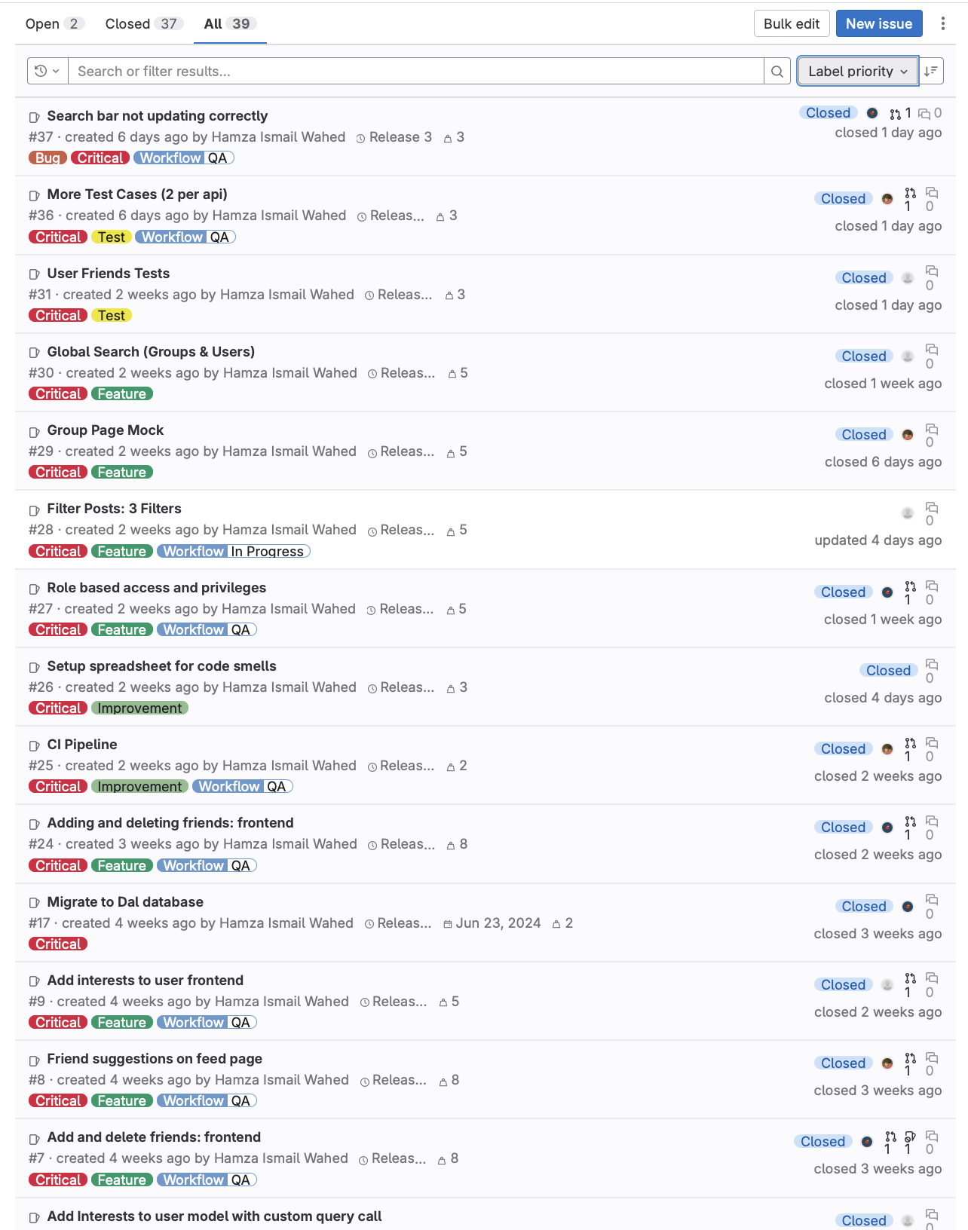
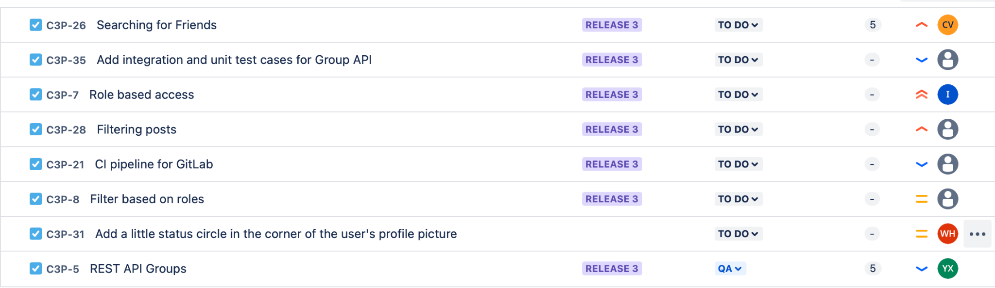
Product backlog
https://git.cs.dal.ca/courses/2024-summer/csci3130/Group01/-/issues/

Slide 5
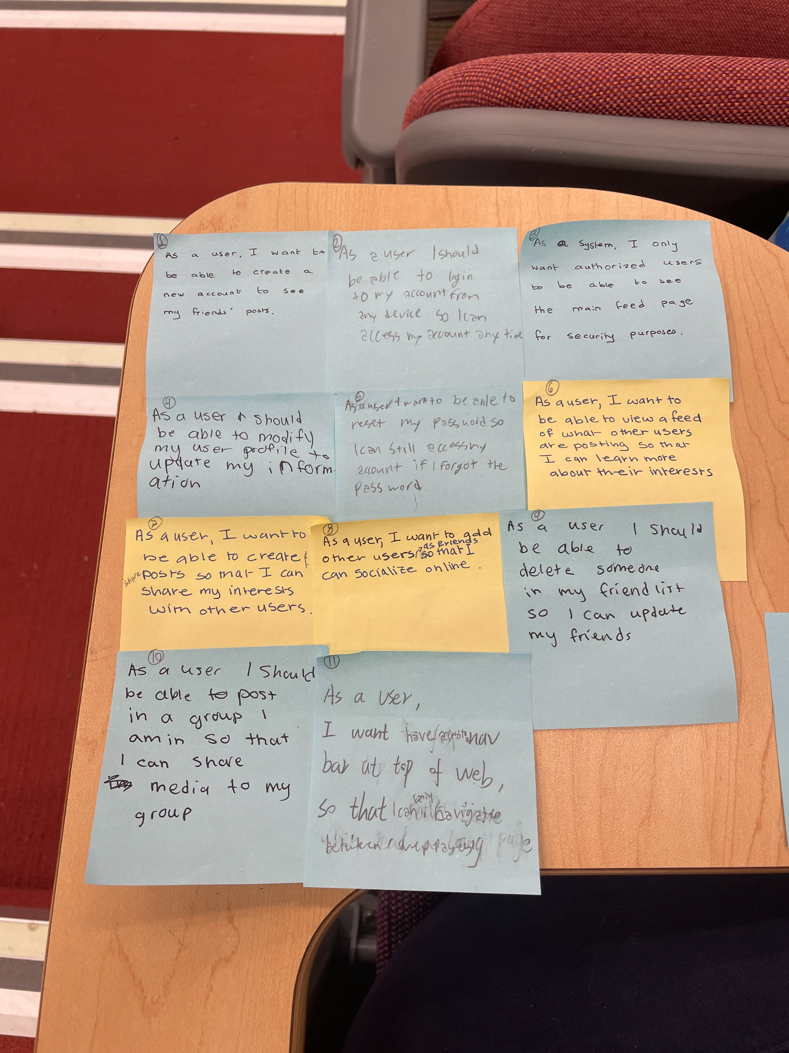
Planning session

Slide 6
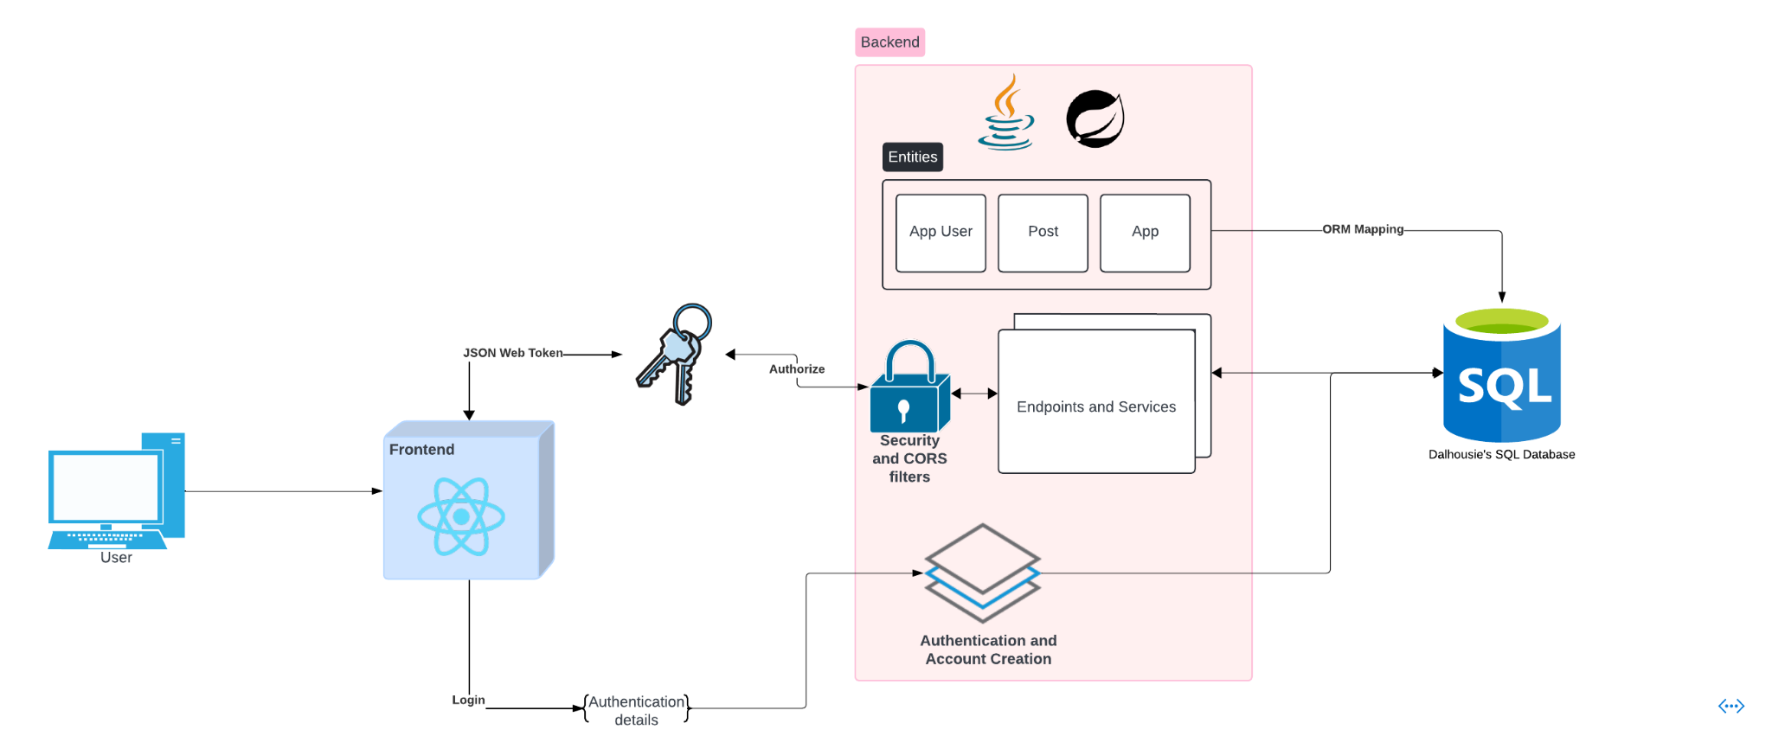
High Level Design Document

Slide 7
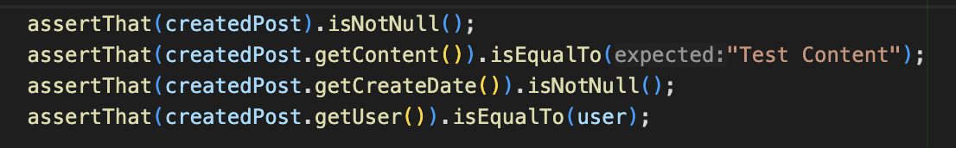
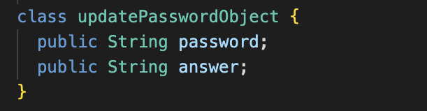
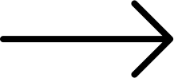
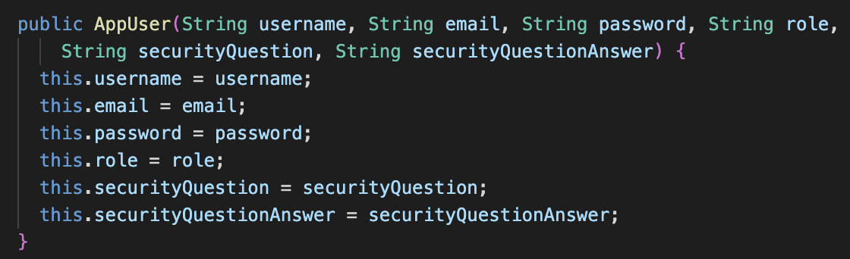
Assertion roulette
Unnecessary abstraction
Code smells
Complex conditional
user.getEmail().isEmpty() || user.getPassword().isEmpty() || user.getUsername().isEmpty()|| user.getSecurityQuestion().isEmpty()|| user.getSecurityQuestionAnswer().isEmpty()
Long statement
AppUser user = new AppUser("root"`"root@dal.ca"`"$2a$12$MZNPCAEkG3QJm76hFtH/p.hdnh0yZGhL6KB4doztx8FzmST7NMbf2"`"ADMIN"`"What is the name of your first pet?"`"Leo");
Long parameter list

Slide 8
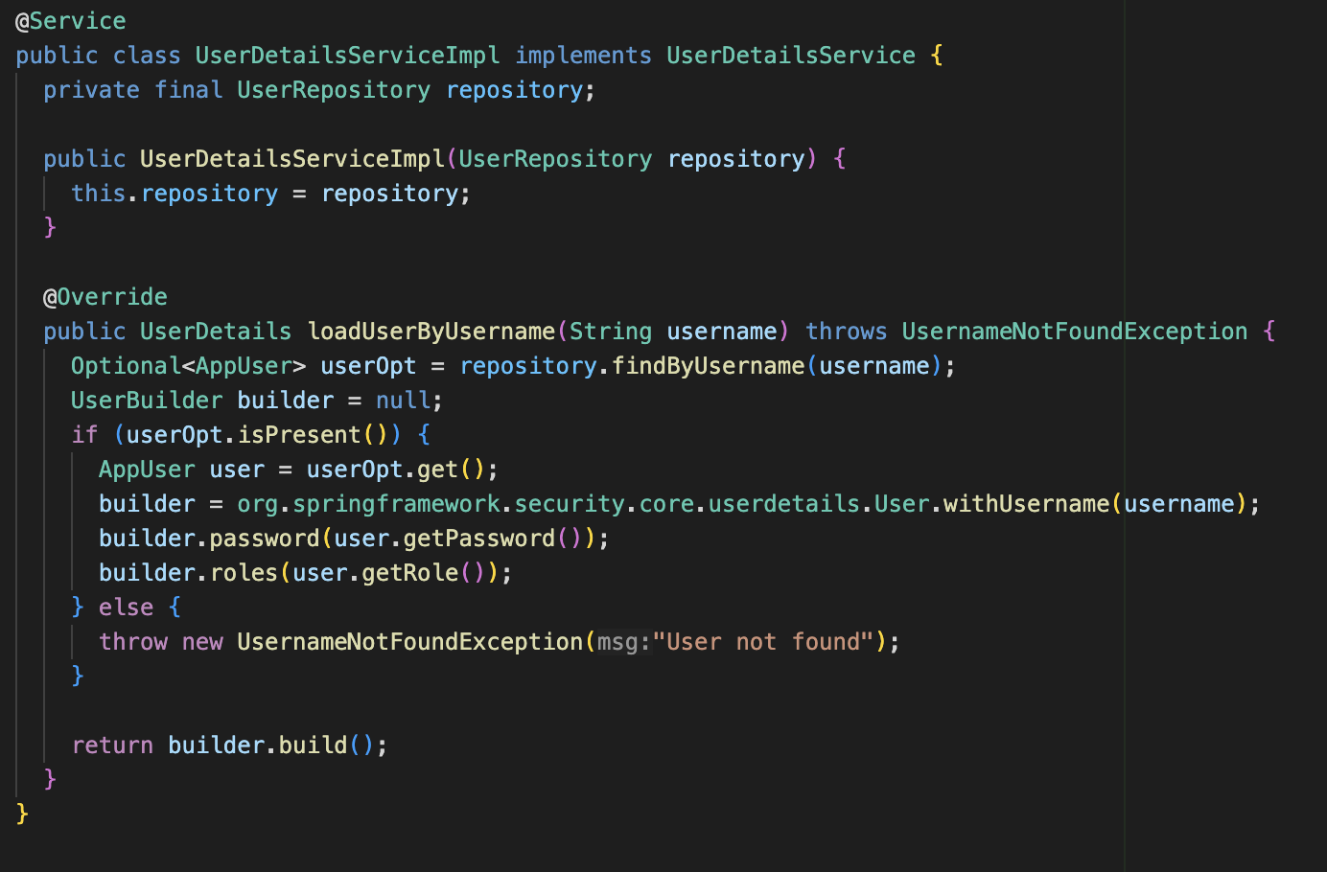
Clean Code
SRP
Clarity & organization
Our UserDetailsServiceImpl class is an example of the Single Responsibility Principle as it solely focuses on user authentication details.
We organized our backend code into layers such as controller, service and repository, and used clear naming conventions AppAuthorizationService and LoginController

Slide 9
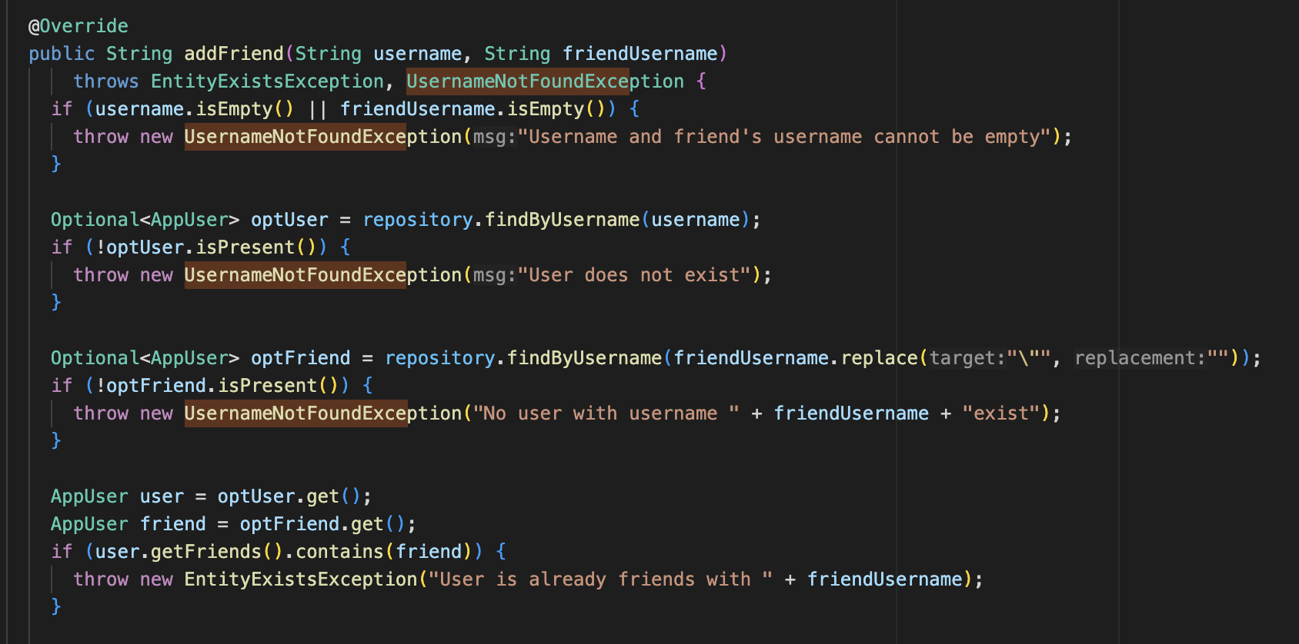
Exception handling
Notes:
We also use the same exception in a bunch of other classes.

Slide 10
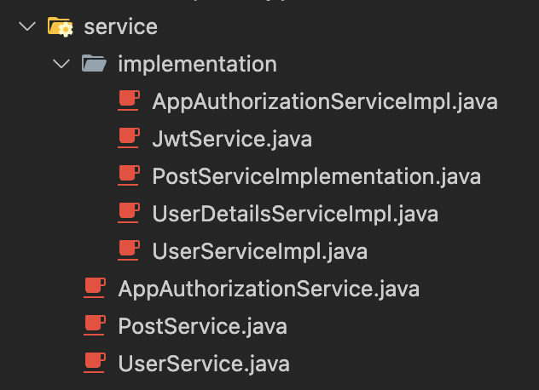
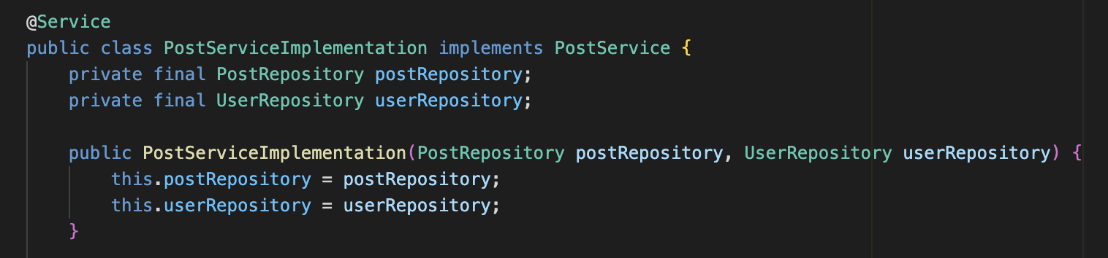
Open/Close Principle
Dependency Inversion Principle
The use of dependency injection in PostServiceImplementation demonstrates DIP. High-level modules do not depend on low-level modules but both depend on abstractions.
All of our services implement interfaces which allows them to be extended without modifying their existing code, adhering to the OCP. New functionalities can be added by implementing the interfaces in new classes.
Notes:
We also use the same exception in a bunch of other classes.

Slide 11
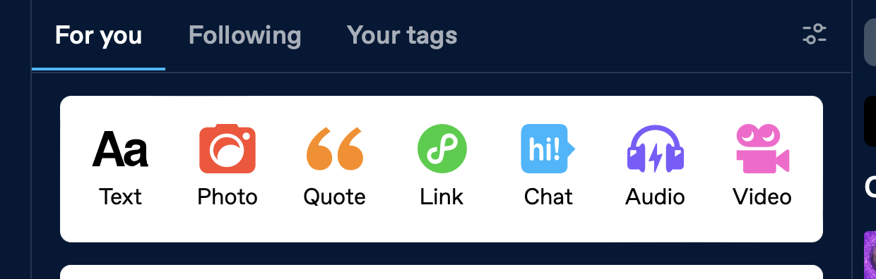
Improvement: Strategy Design Pattern
We could have chosen to expand the functionality of our app by allowing posts to be created and processed in multiple ways, and using the Strategy design pattern to support to do so.
For example, we could have had different categories of post such as “announcement”, “rant”, or “update”, each with their unique visual features and backend attributes.
We then could have used Strategy to encapsulate the differences between these types of posts into separate classes that could be selected as the PostServiceImplementation during runtime depending on what the user selects.
(example from tumblr.com)

Slide 12
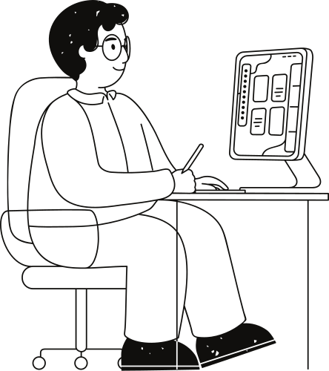
Wins and Setbacks
Advantages we enjoyed:
Two of our team members had relevant experience through previous co-op terms
Everyone was respectful and ready to do work
Highly-organized workflow, everyone had something to do
Disadvantages:
Course involved a big learning curve, hard to get everyone up-to-speed
Limited time meant limited creativity in our design, and a relatively basic app functionality (no interesting features)
Improvements:
Leveraging our knowledge of design patterns to expand app functionality
Placing limits on the amount of work each person should do/placing more focus on team capacity
Notes:
mention how hard it was that we were expected to just learn all of the react/spring boot stuff on the spot. that last bullet point is directed at hamza a lot of the work

Slide 13

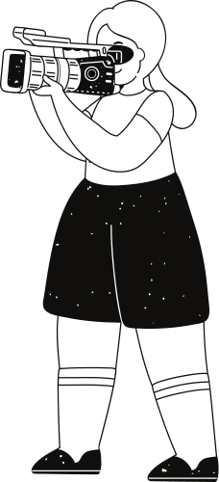

Slide 14
Q & A

